Slide 1
Atlantic Youth Creative Hubs OCEAN
This project is co-financed by the European Regional Development Fund through the Interreg Atlantic Area Programme

Slide 2
1.
WHY AYCH OCEAN WAS NECESSARY?

Slide 3
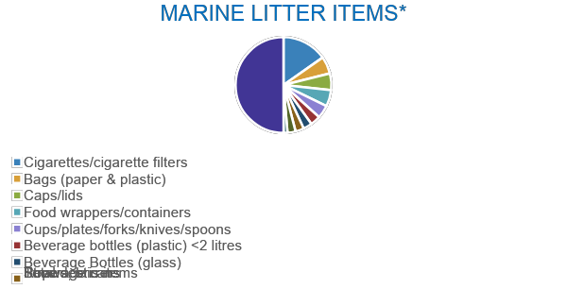
Each year, Europeans generate 25 million tons of plastic waste, but less than 30% is collected for recycling. All over the world, plastic represents 85% of waste on beaches. What's more, plastics reach our lungs and our tables, in the form of microplastics in the air, water and food, with effects unknown to our health.
*Adapted from UNEP (2009a) and compiled from the International Coastal Clean Ups’ 1989-2007 reports of the Center
for Marine Conservation/Ocean Conservancy.

Slide 4
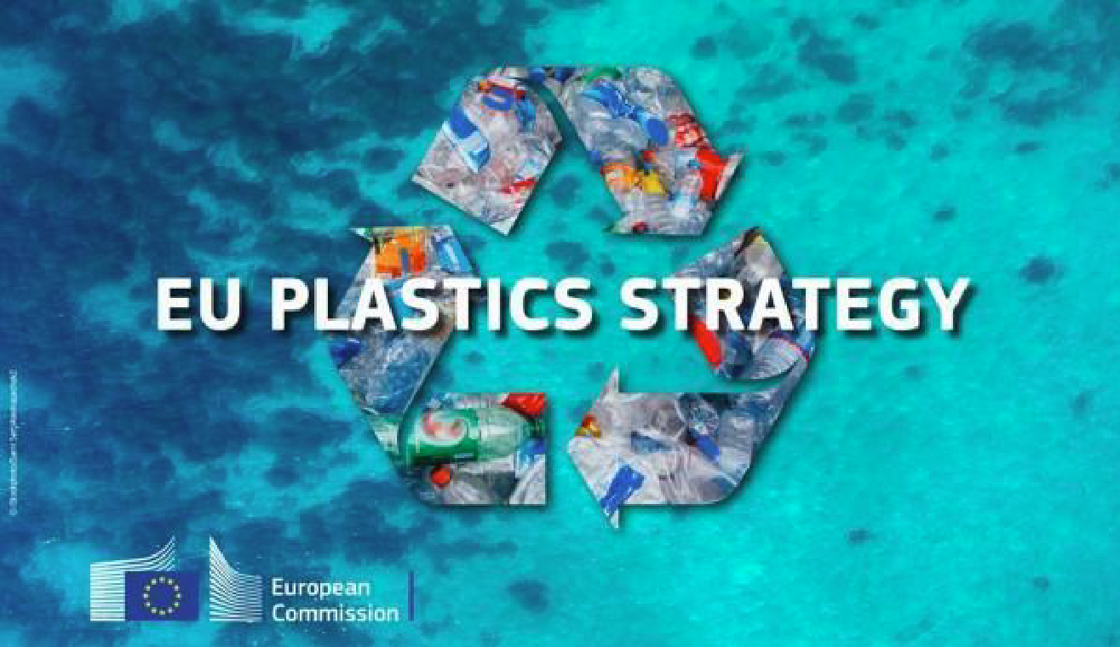
The AYCH OCEAN project is the result of the commitment of the Atlantic Youth Creative Hubs partners to bring young Europeans education in values, focusing on environmental education as a basic principle of life and the protection of the Atlantic Ocean against the growing invasion of plastic garbage.

Slide 5
It has two objectives:
To involve young people from 4 European countries through the Atlantic Youth Creative Hubs project (AYCH) of the Interreg Atlantic Area program in initiatives to conserve the good environmental status of its beaches.
To create educational and informative material, achieving an active and interventive communication of these values with the work of European youth.

Slide 6
2.
HOW DOES IT WORK?

Slide 7
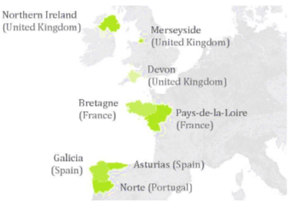
Each country participating in this project can organize a series of activities based on the protection of the oceans through the analysis and involvement of the youngest population.

Slide 8
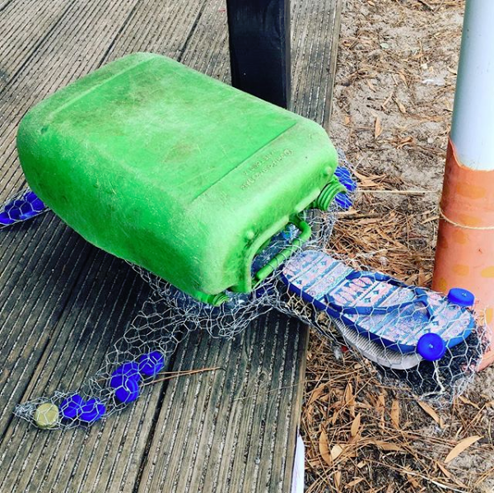
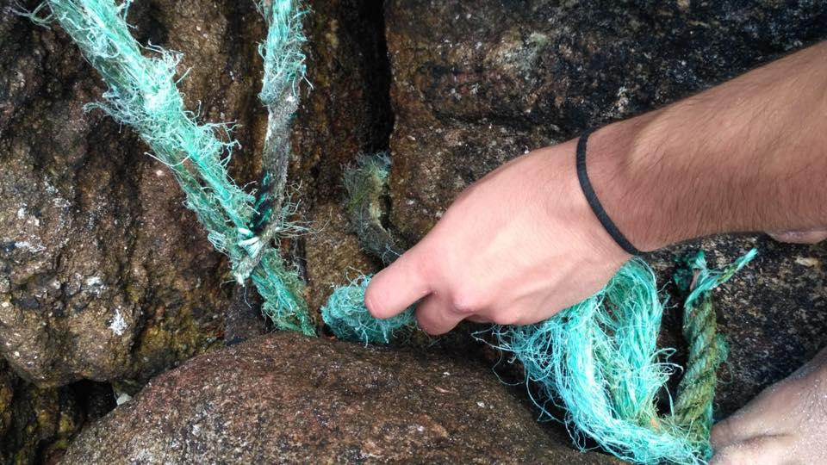
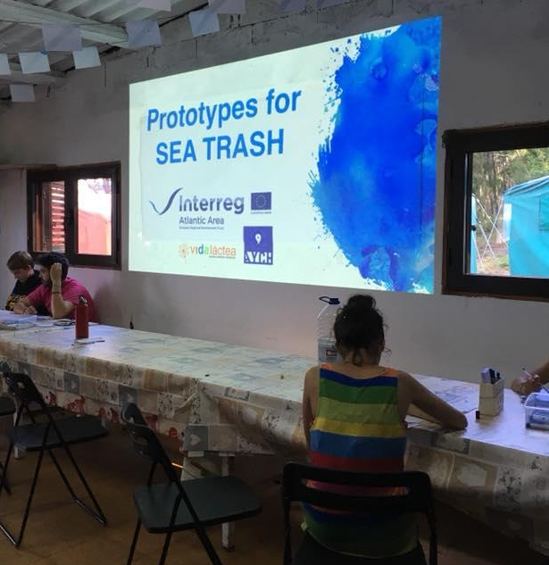
It is important that the AYCH project offers tools for prototyping and training, to establish solutions through new technologies and seek to undertake even business opportunities.
In the same way, the interaction with the marine environment must be paramount; a help project could not be understood without there being a direct contact between young people and the natural environment to see first hand reality.

Slide 9
3.
CÍES WORKCAMP 2018

Slide 10
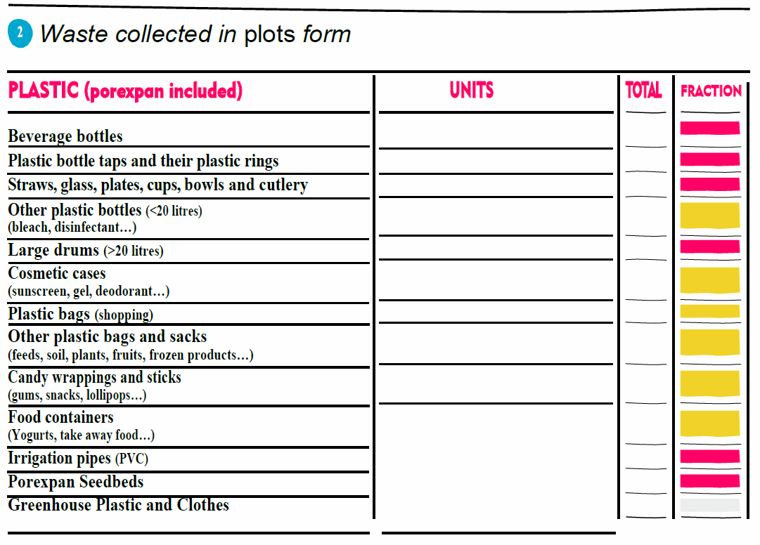
During the Cíes Work Camp, a protocol that specified how to carry out the cleaning of the waste present on the beach, was employed by the members of the work camp for collecting marine litter.

Slide 11
During the first day of arrival to the Work Camp, the volunteers were introduced to the objectives of the activity, as it is done in any Work Camp; they were also informed that they will have to produce a material or immaterial prototype that has as basic guidelines of work the sustainable entrepreneurship and the circular economy.

Slide 12
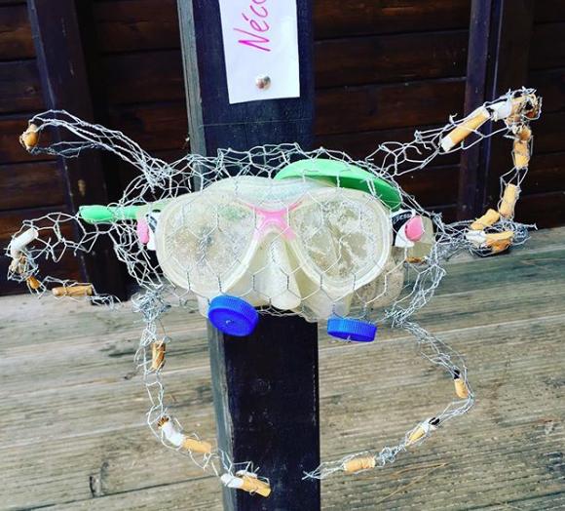
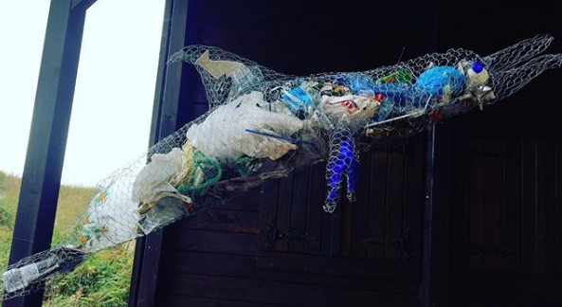
With part of the debris collected, the volunteers made a bunch of art pieces made out of marine litter, called plasticart. Their goal is to show how deadly is the debris for the flora and fauna of our seas and oceans.

Slide 13
The last day of the Work Camp will be an exhibition of the prototypes that will be evaluated by the comrades and the technical team and one of the teams will be proclaimed winner.
By the end of the Work camp, the volunteers will have achieved three main goals:
AWARENESS
OF THE
SITUATION
DO THEIR
BIT
MAKE THEIR
RELATIVES
AWARE OF IT

Slide 14
89,526,124
Whoa! That’s a big number, aren’t you proud?

