Slide 1
Atlantic Youth Creative Hubs ENGAGE
This project is co-financed by the European Regional Development Fund through the Interreg Atlantic Area Programme

Slide 2
1.
Atlantic Youth Creative Hubs

Slide 3
AYCH
ATLANTIC & AMBITIOUS & ASPIRATIONAL
4 Atlantic coast countries
17 partners
14 delivery partners
14+ hubs
5 languages
1 collaborative mission
100’s of deliverables

Slide 4
AYCH
YOUTH & YOURSELF
Up to 30 years
Entry-level to post-graduate
From organisations within and beyond education
Encouraging entrepreneurship, enterprise and employment skills
Countering youth unemployment, under-employment and poor productivity
Life changing and realisation

Slide 5
AYCH
CREATIVE & CHALLENGING & COOL
Future-facing creative and digital skills
Communication, collaboration, flexible and innovative transferable skills which are ‘Assets for Success’
Sustainable and circular economies
Capitalising on previous projects and making a positive difference
Creative mission with creative practice

Slide 6
AYCH
HUBS & HAPPINESS & HORIZONS
Creating hubs of inventiveness and implementation
Linking hubs and sharing expertise and resource
Working virtually to minimise distance
Keeping well-being and positivity in all that we do
Helping AYCH and other Young People reach for the horizon

Slide 7
Origins of AYCH
OPPORTUNITY & ORIGINALITY & OUTCOMES
Response to the marginalisation of arts and creative subjects in education
Re-design of the Youth Service and development of a model to support creative and social enterprise and education in new settings.
Empower young people to present solutions to societal issues of the future

Slide 8
2. Change our vision

Slide 9
Culture shock
Academics
Education
Pedagogy
Model
Youth
Engage
Hack
Experience
Self engagement

Slide 11
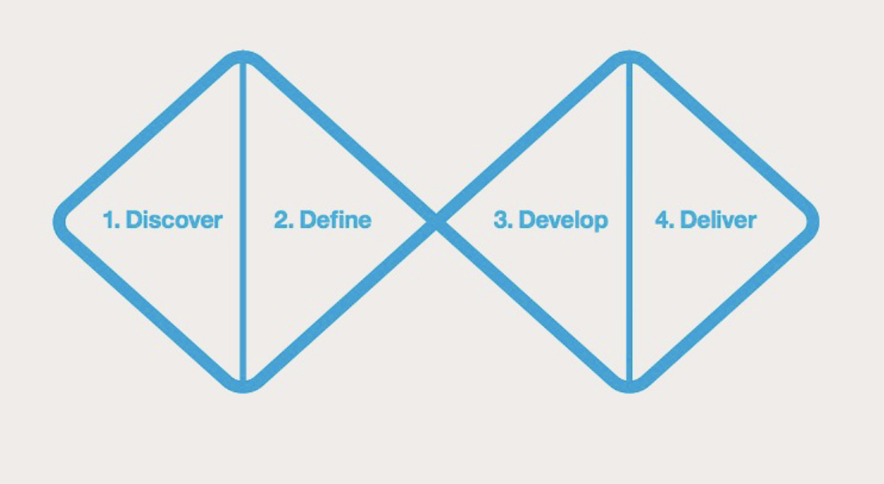
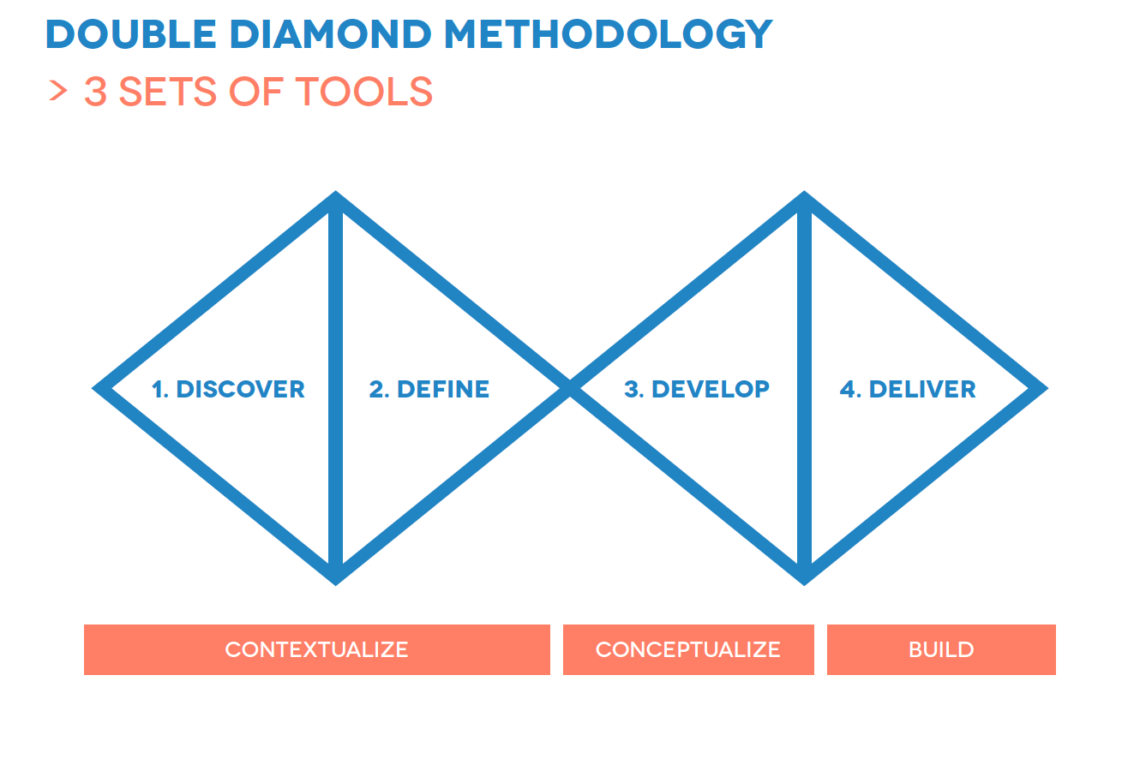

Slide 12
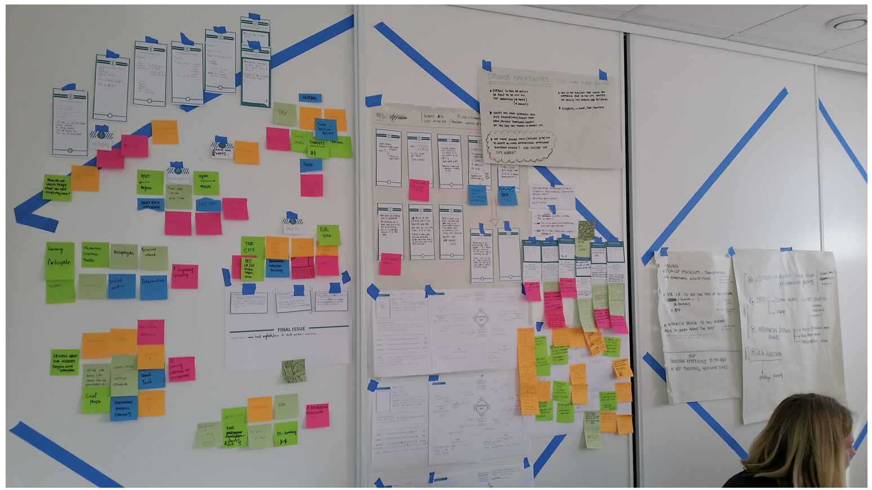

Slide 13
3. ENGAGE !

Slide 14
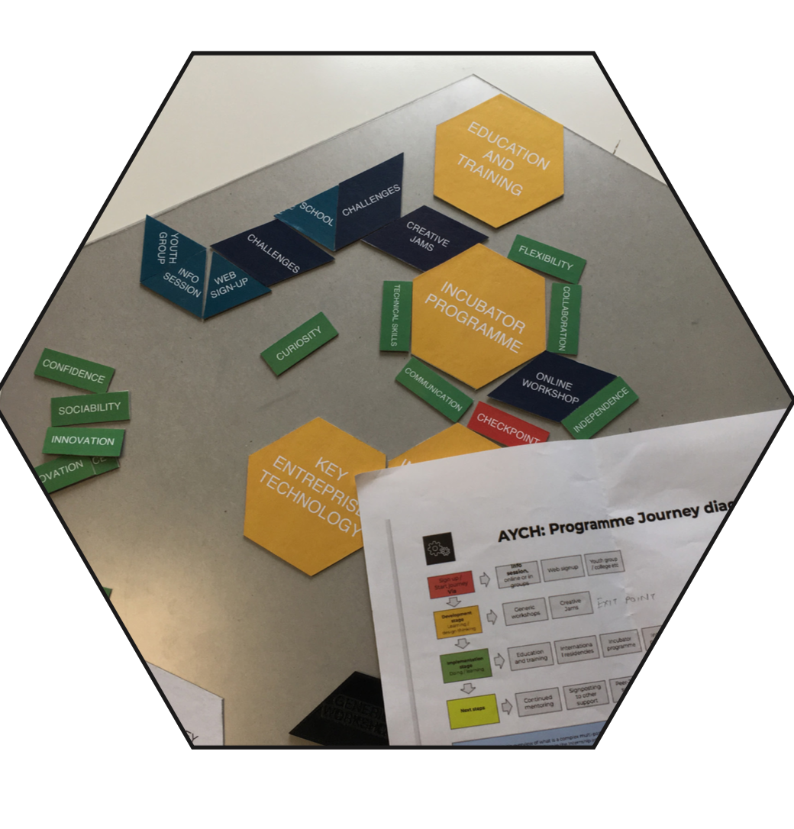

Slide 18
4. SPREAD

Slide 19
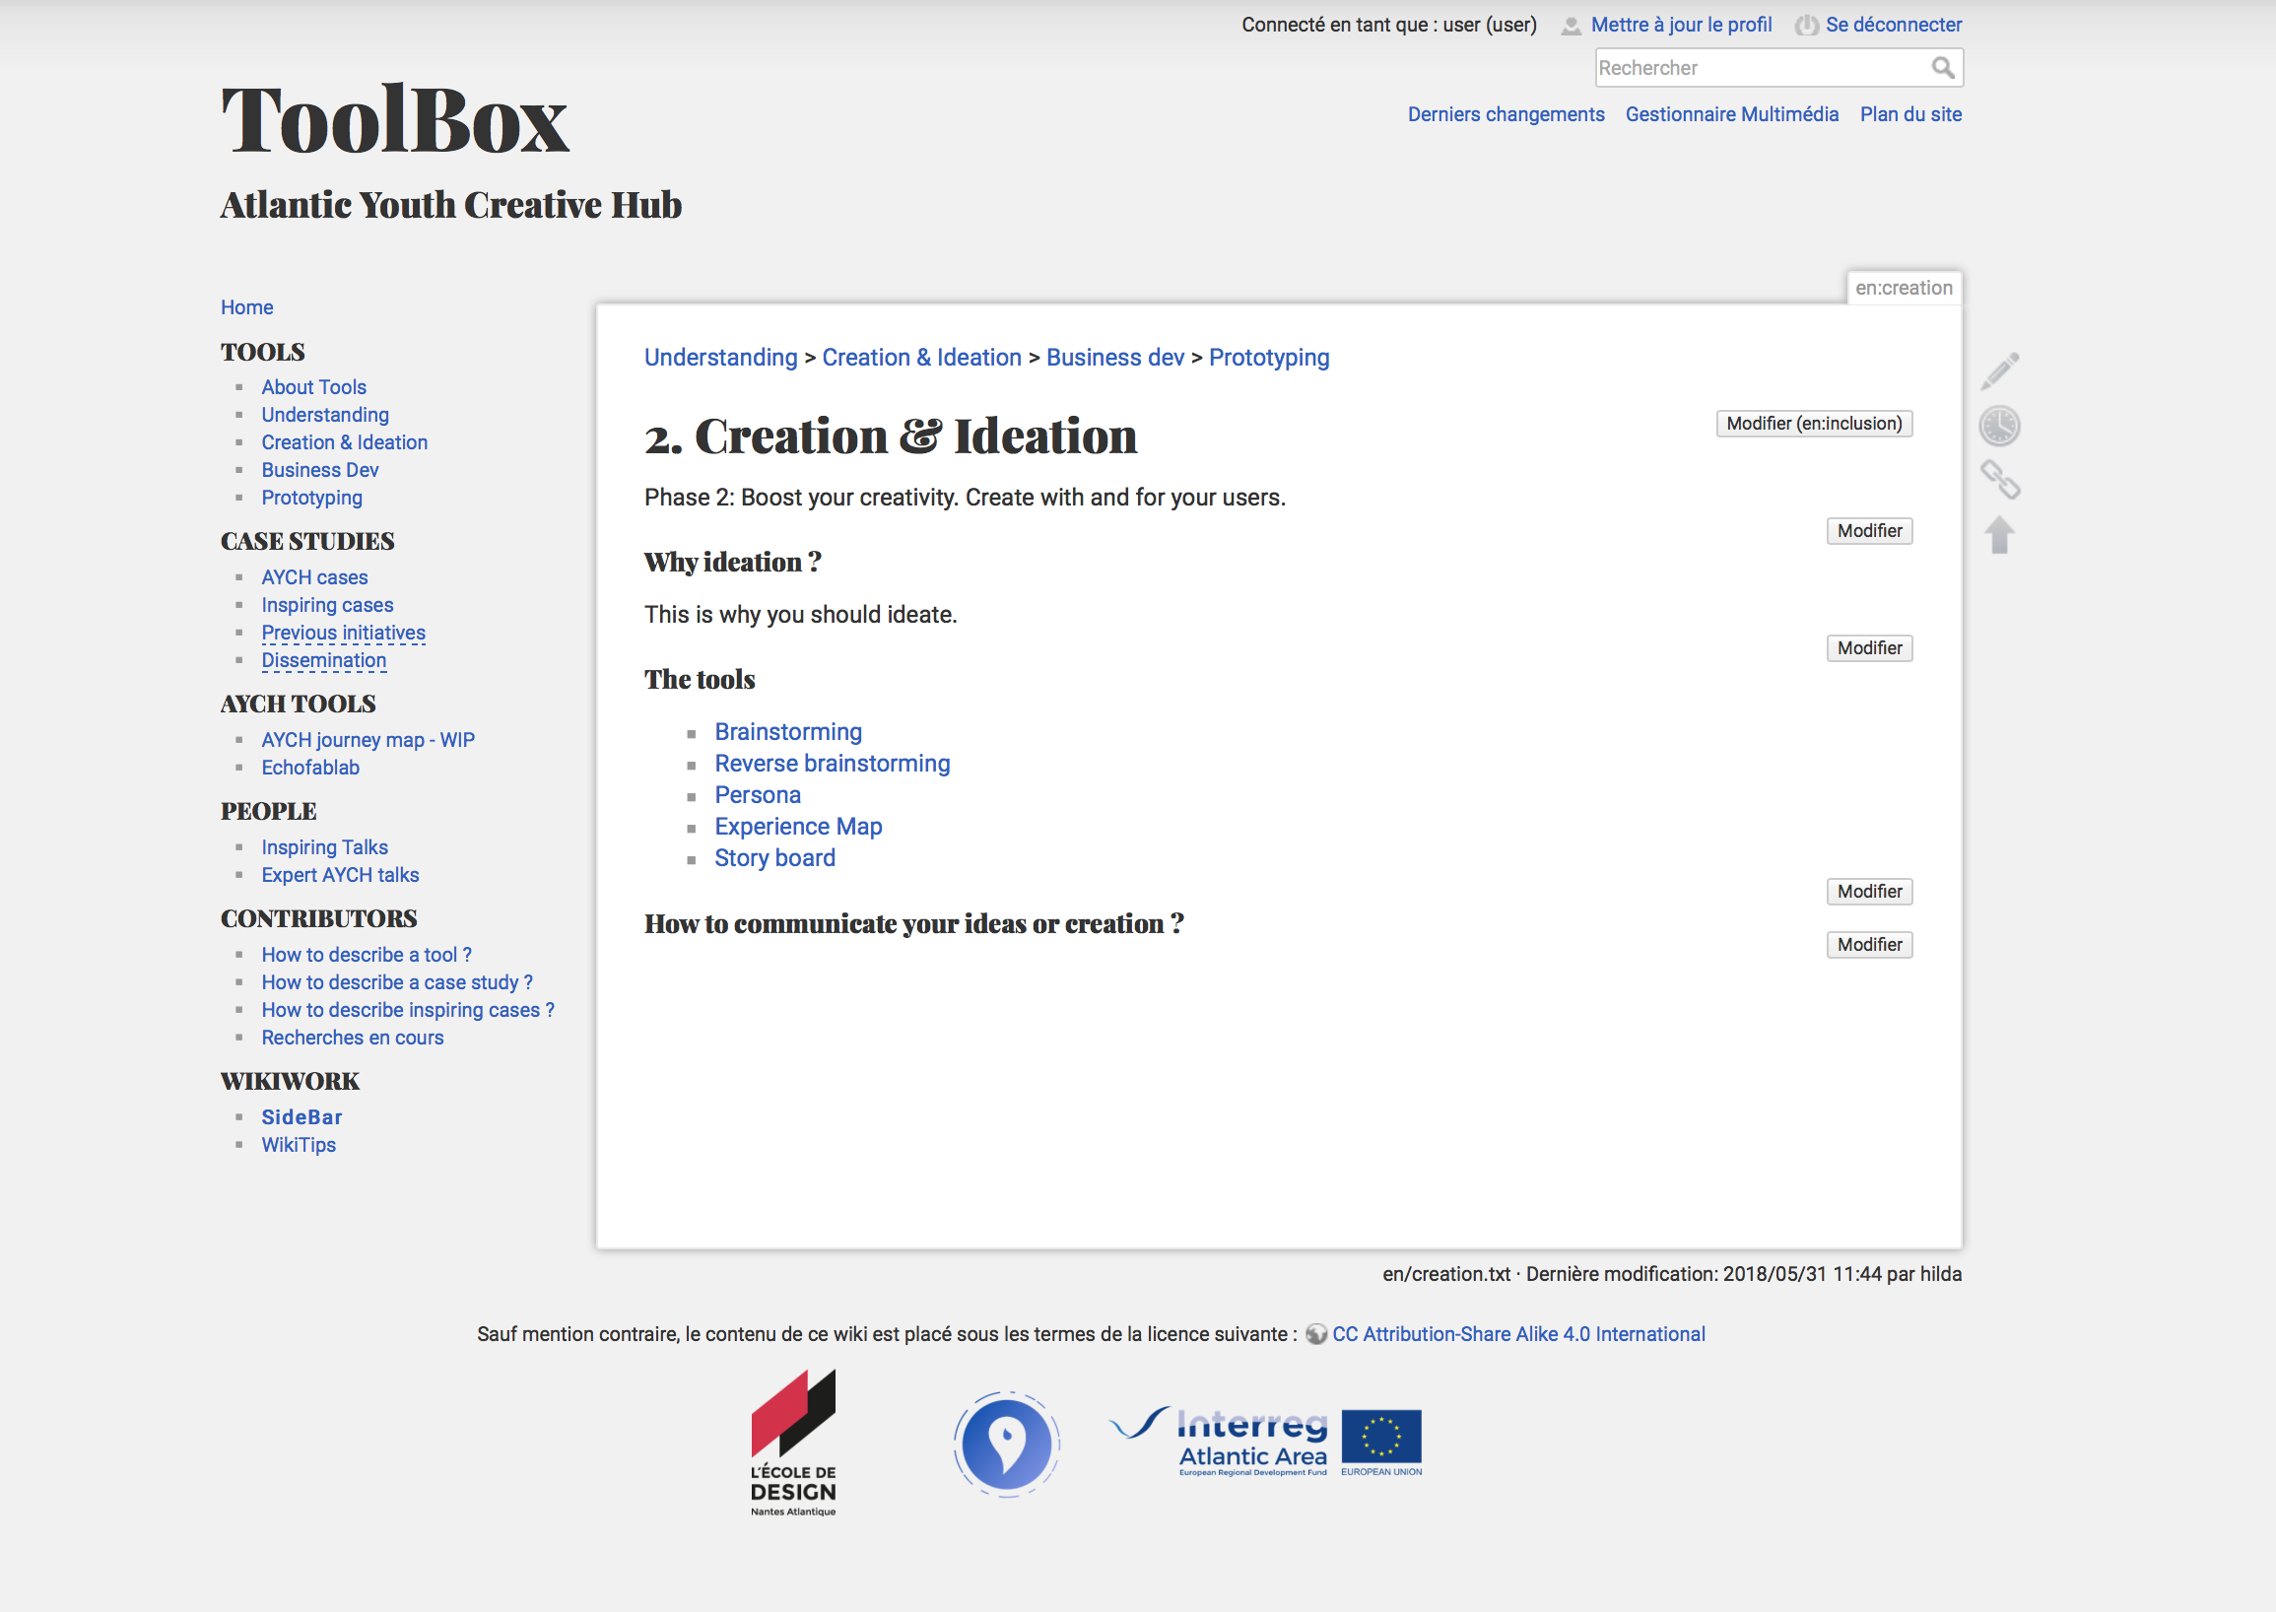
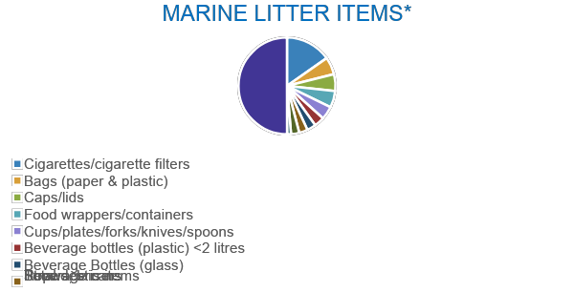
Each year, Europeans generate 25 million tons of plastic waste, but less than 30% is collected for recycling. All over the world, plastic represents 85% of waste on beaches. What's more, plastics reach our lungs and our tables, in the form of microplastics in the air, water and food, with effects unknown to our health.
*Adapted from UNEP (2009a) and compiled from the International Coastal Clean Ups’ 1989-2007 reports of the Center
for Marine Conservation/Ocean Conservancy.

Slide 20
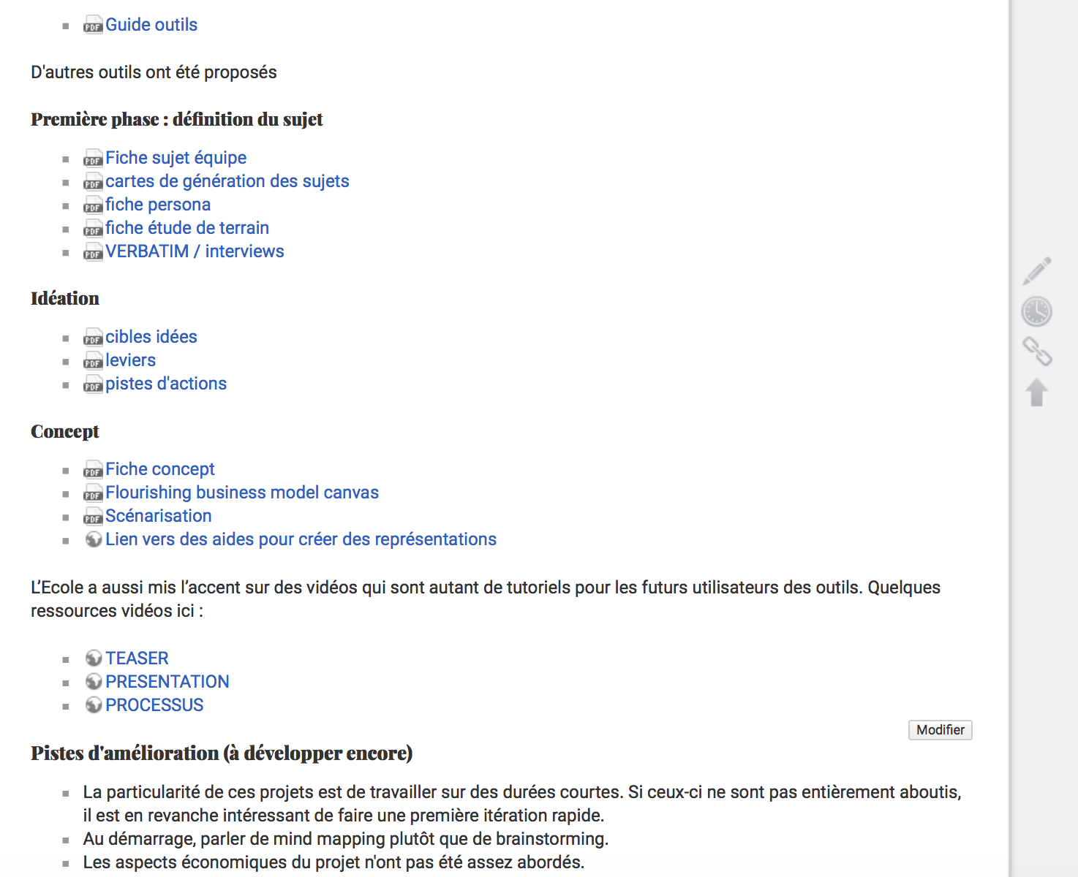

Slide 21
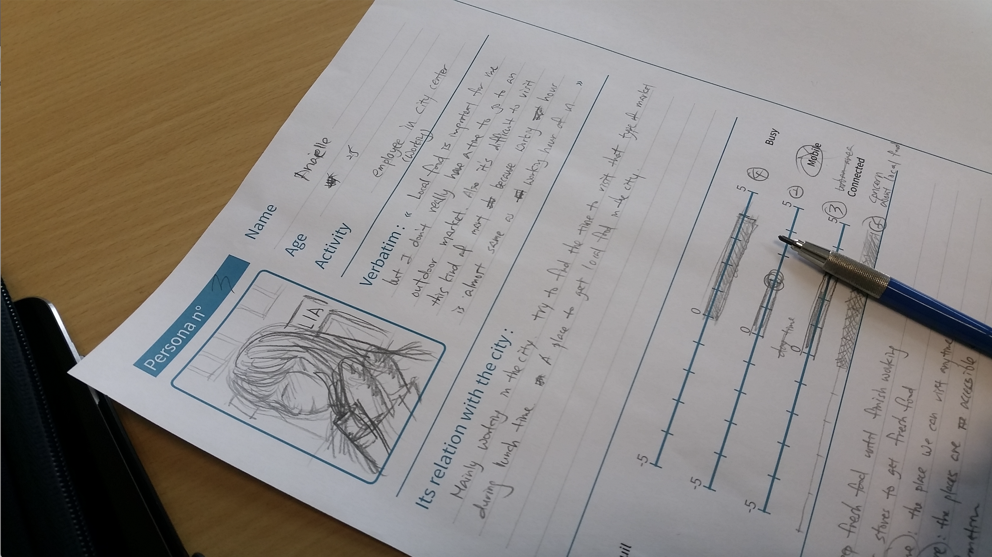
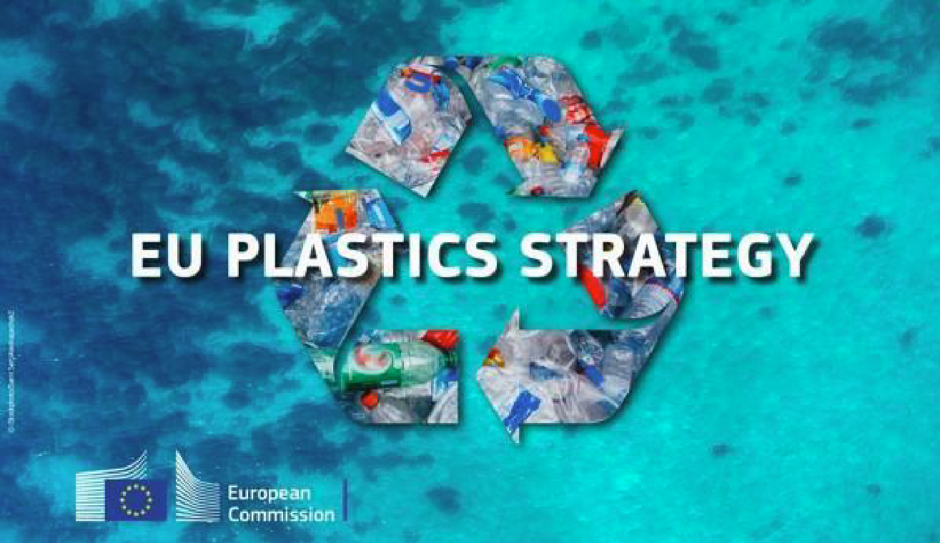
The AYCH OCEAN project is the result of the commitment of the Atlantic Youth Creative Hubs partners to bring young Europeans education in values, focusing on environmental education as a basic principle of life and the protection of the Atlantic Ocean against the growing invasion of plastic garbage.

Slide 22
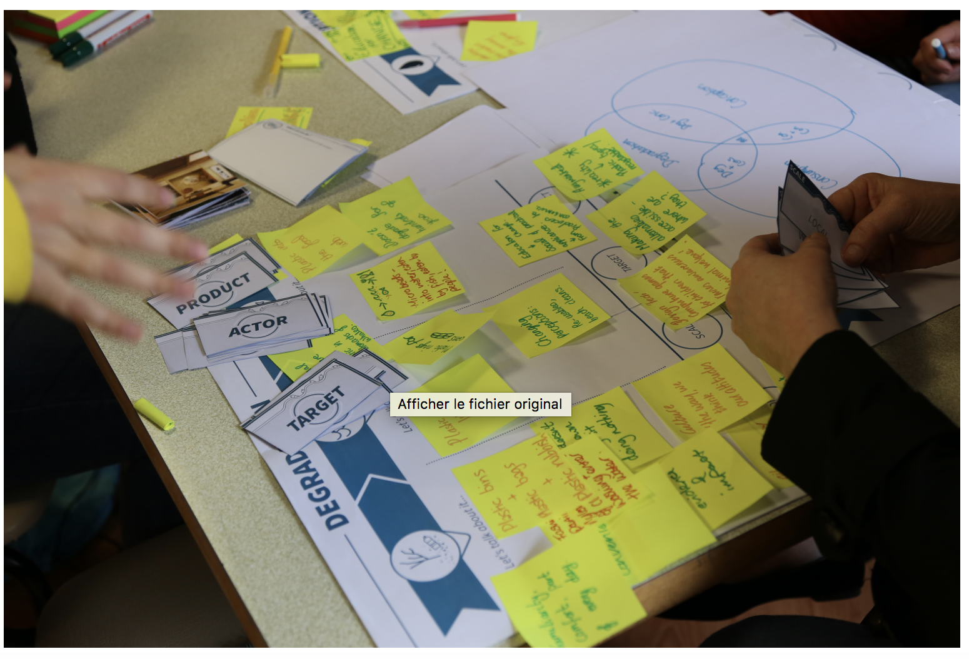

Slide 23
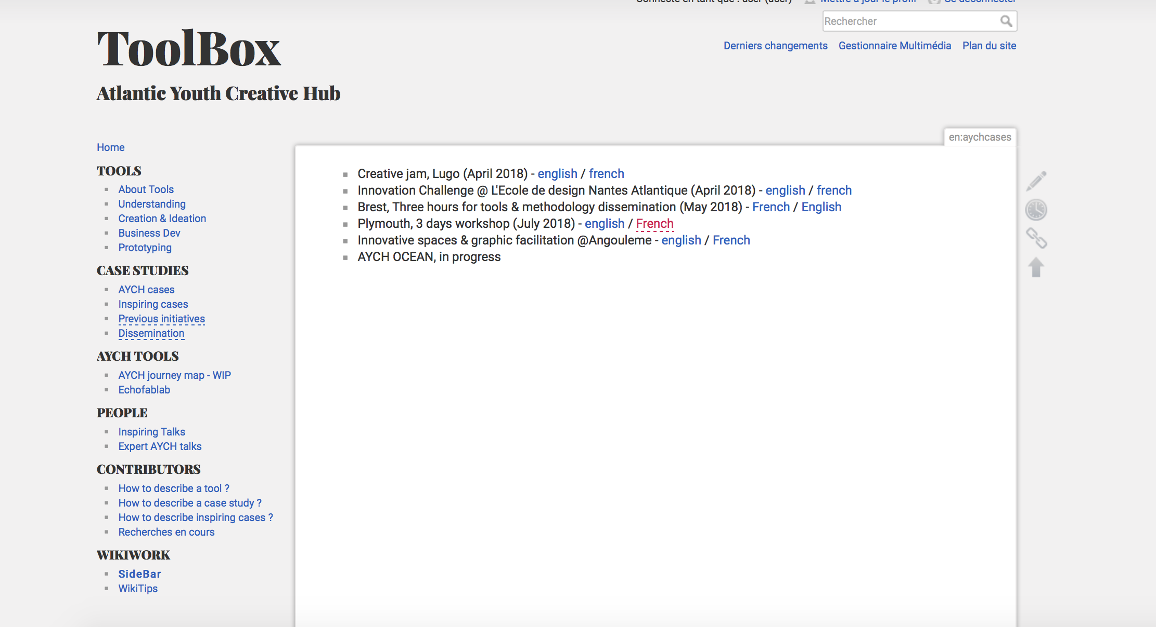

Slide 24
5. Give the power to change

Slide 25
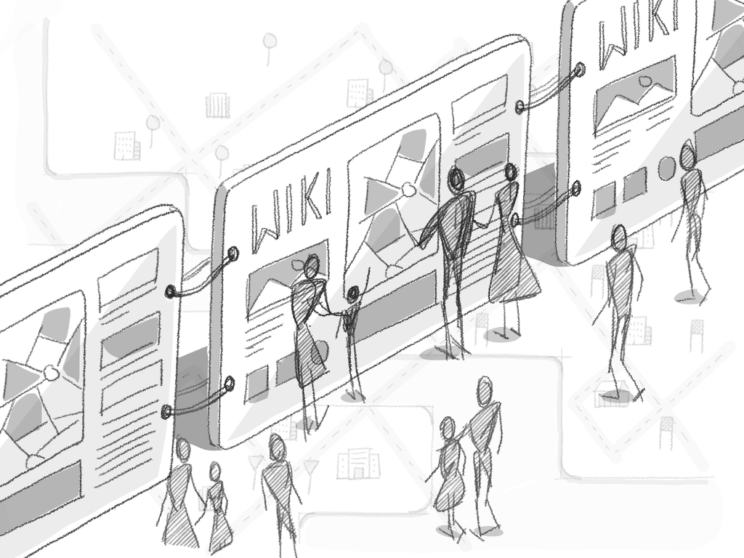
It has two objectives:
To involve young people from 4 European countries through the Atlantic Youth Creative Hubs project (AYCH) of the Interreg Atlantic Area program in initiatives to conserve the good environmental status of its beaches.
To create educational and informative material, achieving an active and interventive communication of these values with the work of European youth.

Slide 26
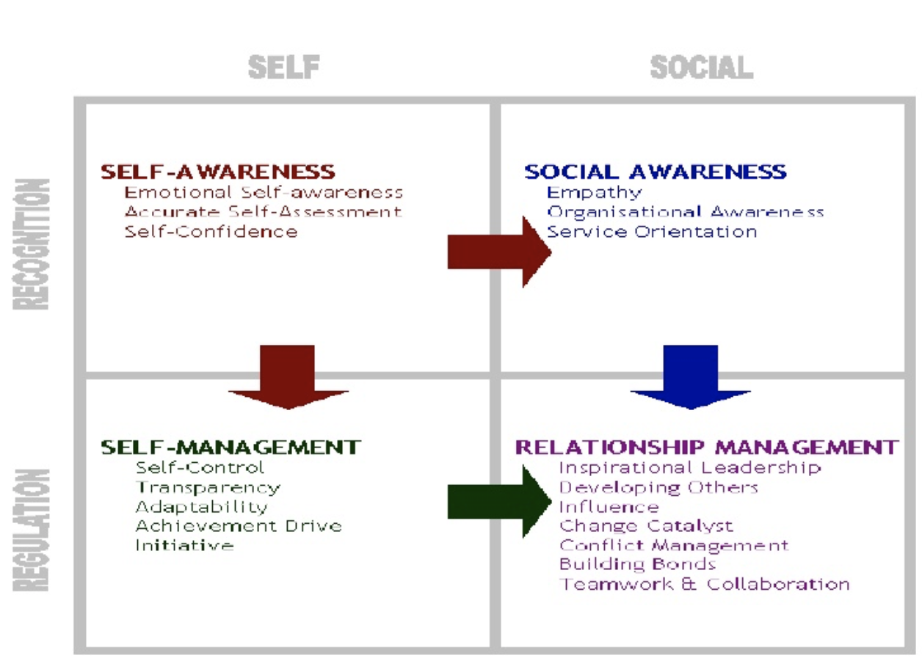
It has two objectives:
To involve young people from 4 European countries through the Atlantic Youth Creative Hubs project (AYCH) of the Interreg Atlantic Area program in initiatives to conserve the good environmental status of its beaches.
To create educational and informative material, achieving an active and interventive communication of these values with the work of European youth.
https://www.slideshare.net/swathivasista/self-awareness-and-self-esteem

Slide 27
Atlantic Youth Creative Hubs
This project is co-financed by the European Regional Development Fund through the Interreg Atlantic Area Programme

